Slide 1
SCALING Your Window Treatment Business

Slide 2
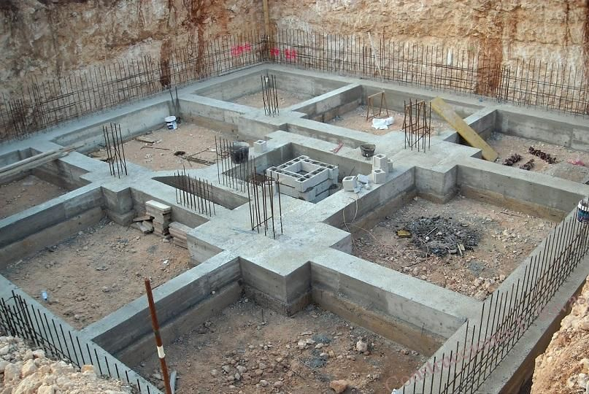
Process Flow Charts = Foundation

Slide 3
Project Management System = Walls

Slide 4
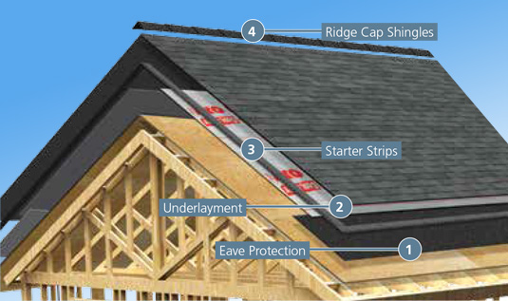
Processes = Roof

Slide 5
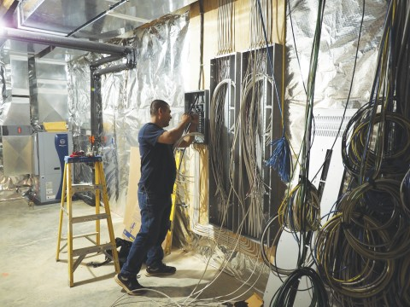
H-VAC, ELECTRIC, PLUMBING = PEOPLE

Slide 6
Week 1: April 8th - Process flow charts
Week 2: April 15th - Project management
Week 3: April 22nd - Systems & processes
Week 4: April 29th - People
Whom to hire
When to hire
How to hire
How much does it cost
What to do once hired
How the CEO role changes
Week 5: May 6th - Finances
Week 6: May 13th – Mindset and Q&A

Slide 7
VITALIA INC. – COMPANY STRUCTURE
CEO
WTS
GM
SEAMSTER
INSTALLER
BOOKKEEPER
MARKETING
COORDINATOR

Slide 8
VITALIA INC. – COMPANY STRUCTURE
CEO
WTS
GM
SEAMSTER
INSTALLER
BOOKKEEPER
MARKETING
COORDINATOR
Help around the house
Tech Support

Slide 9
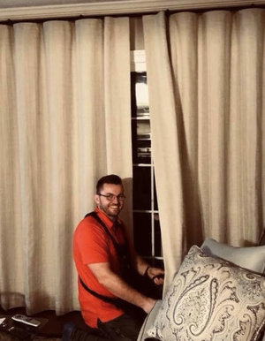
CEO
Window Treatment Specialist – 40hrs/wk
General Manager – 40hrs per wk
Seamster-60hrs/wk
Installer – 2.5days/wk
Bookkeeper – 4hrs/wk
Marketing coordinator - retainer

Slide 10
WHOM TO HIRE FIRST
Bookkeeper
Lots of bookkeepers
Fastest and easiest to train
Can be a contractor
Can be virtual
Your time is MORE valuable than most expensive bookkeeper
But’s:
I’ve always done it
I like it
I’m a numbers person
It doesn’t take that much time
I’m not organized enough
I’m afraid to give up control
Refer to your “why”.
You are all here to get back your time.
This is how!

Slide 11
WHOM TO HIRE NEXT
Office Administrator
List of Tasks
1. Manage Air Table (AT), as our main project management tool
Set up new customer, as info becomes available (remember to update info as it’s trickled from designer)
Move the customer in to the appropriate phase of the project
Update financial information: order total, deposit amount and date, balance amount and date, taxable or not, whom to bill
Update customer notes based on progress, update date column
Send out designer reports every two weeks
2. Expediting
Place purchase orders: fabric, hardware, hard-goods, etc.
Go through the confirmations to make sure vendor orders reflect what was actually ordered
Follow-up on purchase orders and ETA’s
Deal with problems, know when to escalate to CEO
Track packages, interface with vendors
Receive purchase orders shipments (open boxes, count components, check-in against original paperwork, make sure all finish, projections, sizes match)
Communicate with client every week (stay ahead of the client)
Set up fabrics, trims, other components (pillows, buttons, etc.) in the workroom
Be aware of the moving schedules, customer availability, and designer requests – adjust workroom and installation priorities accordingly
Update AT at every step

Slide 12
WHOM TO HIRE NEXT
Office Administrator
List of Tasks
3. Installation
Create installation calendar entries based on timelines. Post in workroom every week
Prepare all finished goods for installer to pick up by labeling the room and setting them aside in designated areas
Update calendar notes with customer name, location, driving or arrival instructions (i.e. door code, cat in house, etc.), any additional directions given by client or designer
Share production orders and leave in installer folder
Work with bookkeeper
Communicate with client two weeks prior with target date, then one week prior with time
Request COI
Update AT

Slide 13
WHOM TO HIRE NEXT
Office Administrator
4. Financial
Accumulate and classify purchase receipts
Download capital one and populate with descriptions – every Tuesday morning, prior to bookkeeper commencing weekly work
Scan checks at end of month and prepare deposit
Follow up on outstanding accounts receivables
Interface with bookkeeper on questions and follow-up
5. Marketing
Execute designer marketing campaigns (i.e. summer, thanksgiving, etc. campaigns)
Send out e-mails from Vita’s account (i.e. review)
6. General/Office
Keep up with filing
Fill out various forms (credit forms for vendors, etc.)
Order supplies: linings, cartridges, batons, trash bags, foam, pillows, etc.
Manage inventory of supplies: all of the above, left-over hardware
Pick ups: MYL, Stout, etc.
Misc. store runs (True Value, Dollar Store, etc.)
Keep offices organized
Deliveries to clients
Shipping: finished goods, returns, etc.
Weekly trash

Slide 14
HOW TO HIRE
JOB POSTING
JOB DESCRIPTION
One page
To the point and succinct
Selling the opportunity
Bullet-point list
Posted to employment sites and SM
Long
Detailed
E-mailed to candidate prior to interview
Outsource
your hiring process!
www.EileenHahn.com
www.BehindtheDesign.com

Slide 15
HOW TO HIRE and RETAIN - CHECK LIST
Job posting
Job description
Interview questions
Offer letter
Welcome letter
On-boarding check-list
List of expectations (at 30days, 60days, 90days)
Weekly routine
Weekly check-list
Evaluation form
Workman’s comp insurance
We use Gusto.com to set-up new employees and process payroll

Slide 16
WHEN TO HIRE
Where is my financial ceiling:
How much revenue and profit can I feasibly make,
before making 1st hire AND working overtime?
 | Total Annual Revenue
Company Role | $500K | $700K | $1M
WTS | 20hrs | 30hrs | 40hrs
Admin | 20hrs | 30hrs | 40hrs
Fabrication | 40hrs | 60hrs | 80hrs
Installation | 1.5d | 2.5d | 3.5d
(Leadtime) | 4wks | 4-6wks | 6-8wks
Bookkeeping | 3.5hrs | 4.5hrs | 5.5hrs
Footnotes:
Full-service window treatment firm
Located in the Philadelphia area
60%-40% split between soft and hard treatments
Runs at close to peak efficiency
Figures are PER week
Figures are guides and are not meant to reflect comprehensive survey or research

Slide 17
GM TO DO LIST TEMPLATE

Slide 18
GM TO DO LIST – IN REAL LIFE

Slide 19
EMPLOYEE EVALUATION
E-mail Invite:
Subject line: Quarterly Evaluation
In the body of the invite:
The goal of these is to have an open conversation so that you can feel supported in doing the best job possible.
In preparation, think about these questions:
In the last period (ie. 30 days, 60days, quarter), these things I did well ______ (fill in the blank)
Here’s where I need more improvement _______ (fill in the blank)
I can use support in these areas _________ (fill in the blank)
My biggest motivator is ___________ (fill in the blank, it’s ok if it’s more than one)
Best way to manage me is ____________ (fill in the blank, it’s ok if it’s more than one)
My goals for next quarter _________ (fill in the blank)
If there is anything else we need to talk about, in private, perhaps something we don’t usually get to in the normal course of the day – please bring it here.
Looking forward to meeting together.
v.

Slide 20
EMPLOYEE EVALUATION

Slide 21
HOW MUCH DOES IT COST
Breakdown by role (Philadelphia area):
WTS - $60K - $75K annually; $30-$40 per hour
Admin - $55K-$75K annually; $25-$30 per hour
Fabrication skilled - $15-$25 per hour
Fabrication unskilled - $12-14 per hour
CEO - $100K minimum
Payroll is ~40% of Vitalia Inc’s revenue

Slide 22
MANAGING COSTS OF HIRING
Hire help around the house first
Trust the hiring process
Only hire exceptional people
Hire slow, fire fast
Part time is ok
Virtual is ok (VA)
Hire for a long term

Slide 24
Your homework is to SHARE:
Your plans
Your thoughts
Your concerns

